Slide 1

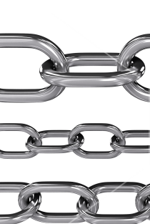
Inside-Outside:
a post-Covid exploration of the possibilities of art education
Janinka Greenwood
University of Canterbury, NZ
INSEA 2020
International Virtual Conference
Art Education in the Time of Coronavirus, Reflecting on Today, Anticipating Tomorrow

Slide 2

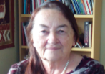
Hi!
An entirely on-line conference means I cannot see you or talk with you
And that makes me unsure…
Many of you in INSEA are visual artists, and perhaps you do usually work inside your studio bubble and only share your work with the outside when its finished.
I work in drama and we make our work collaboratively with other people. And we make it again as we share it with our audience.
For me conferences are about talking to people
Even when you give a keynote you can pick up on energy and interest of the people before you take the podium and you can read your audience
But I’m sitting inside my Covid-bubble at my laptop talking only to myself.
That’s lockdown!

Slide 3
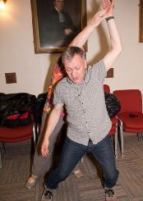

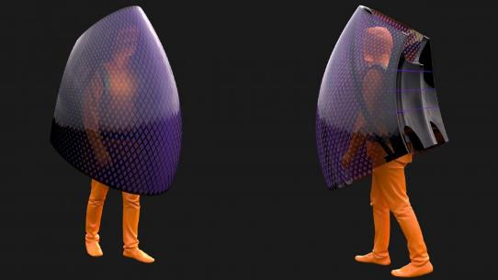
Now in the last quarter of a year dominated by Covid
Anxiety in January, lockdown in March, no active cases in June, back to lockdown in August
Overlaid with border closure, political wrangling, conspiracy theories, and continuing global rise of the virus
Over time our energies and minds have become increasingly locked down
Planned projects have lost momentum
I come from a Drama background, with membership In IDEA since its birth, and participation in 2 WAAE conferences
Although there are many commonalities across the arts – both in genesis of making and in using arts for education. there are also important differences
I will particularly focus on using drama as a medium for learning.
Sun Dayong : wearable coronavirus shield, https://www.dezeen.com/2020/02/26/sun-dayong-coronavirus-protection-shield/?li_source=LI&li_medium=bottom_block_1

Slide 4
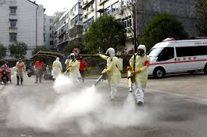
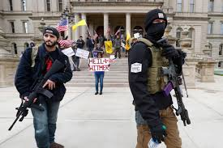




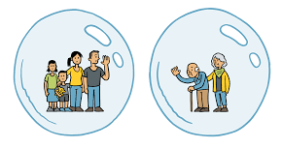






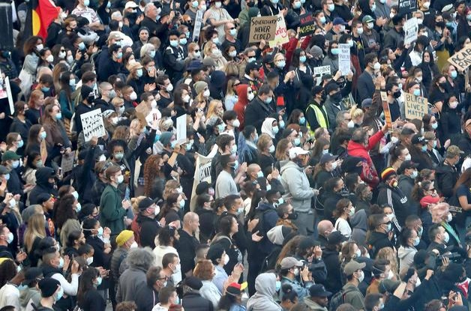

lockdown isolation & insulation
virus
infectious & mysterious
demonstrations race
power
political interests, human rights
sectarian angers.
truths & speculations
economic brink

Slide 5


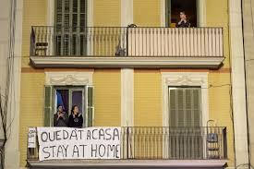

Slide 6
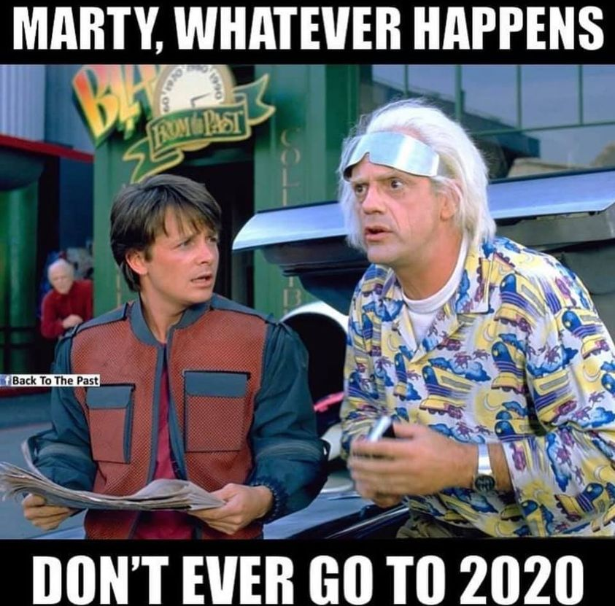
Covid
+ its conspiracy series
unemployment & financial ruin
racial unrest and uprising
elections and politics
gossip, lies, social media
weather changes – draughts & floods
wild fires
burning of refugee camps
polar ice sliding away
(NZ the mosque shooter’s trial )
from Facebook page of a friend)

Slide 7
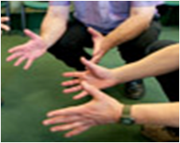
danger, hope, fear, frustration, longing
rumour, lies, truth,
Sense-making
critique
witnessing
art
loss, love, separation, discovery, fracture, disempowerment

Slide 8
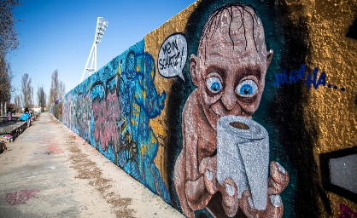
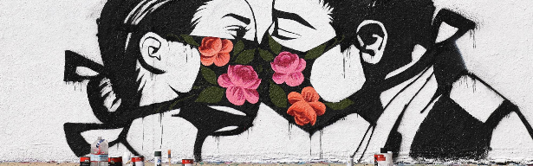

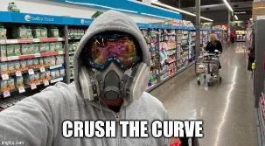
A street art piece by artist Pony Wave, https://www.smithsonianmag.com/travel/how-street-artists-around-world-are-reacting-to-life-with-covid-19-180974712/
Graffiti , Berlin https://www.smithsonianmag.com/travel/how-street-artists-around-world-are-reacting-to-life-with-covid-19-180974712/
art –making provides a medium
And a critical yet visceral framework to question, explore and make at least transient and perhaps troublesome sense of the inner human situation and the world outside.
Facebook page of Abdullah Mohd Nawi, 22 4 20
Facebook page of Neil Holden 29 3 20

Slide 9

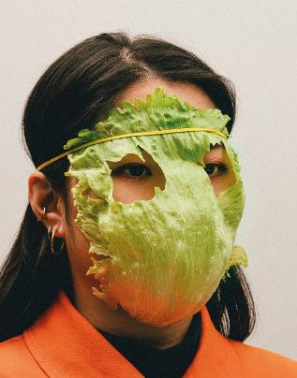
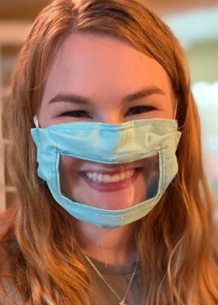
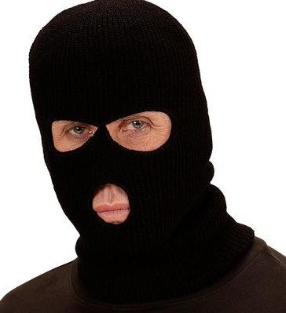

ritual
improv
https://www.google.com/search?q=masks&rlz=1C1GGRV_enNZ811NZ811&sxsrf=ALeKk03Gt3T7gmEm7A-Q_wCbnpXeQ_kzug:1600391394914&source=lnms&tbm=isch&sa=X&ved=2ahUKEwjoqeHEwvHrAhWpzTgGHX7QATwQ_AUoAXoECA0QAw&biw=1023&bih=748#imgrc=AwyODVzBYRmx2M
https://restaurantandcafe.co.nz/read-my-lips-with-a-face-mask-you-cant
Siedentopf: How-To Survive A Deadly Global Virus, https://www.dezeen.com/2020/02/17/alternative-coronavirus-masks-max-siedentopf/
mask
means?

Slide 10
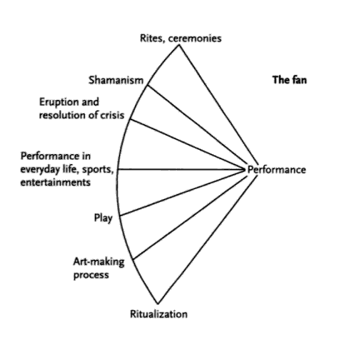
Schechner positions ritual as the source and continuing reference point for theatre and drama
Ritual is performed,
it is efficacious
key elements need to be precisely enacted
Actors have direct agency
Audience is the community of belief and practice
Dramatic symbol is central
Contemporary solemn rituals:
  Marriage ceremony
  Graduation
  Mass
  Powhiri
Post-Covid rituals:
Lining up outside supermarket
Clicking Covid-tracer ap
Handwashing
Schechner., 1977

Slide 11
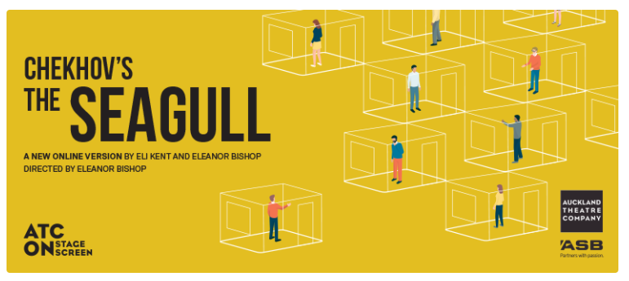
Auckland Theatre Company rehearses and performs The Seagull through Zoom
exploring isolation and fractured communication
Advertisement for The Seagull, https://www.eventfinda.co.nz/2020/chekhovrs-the-seagull-new-online-version/virtual

Slide 12
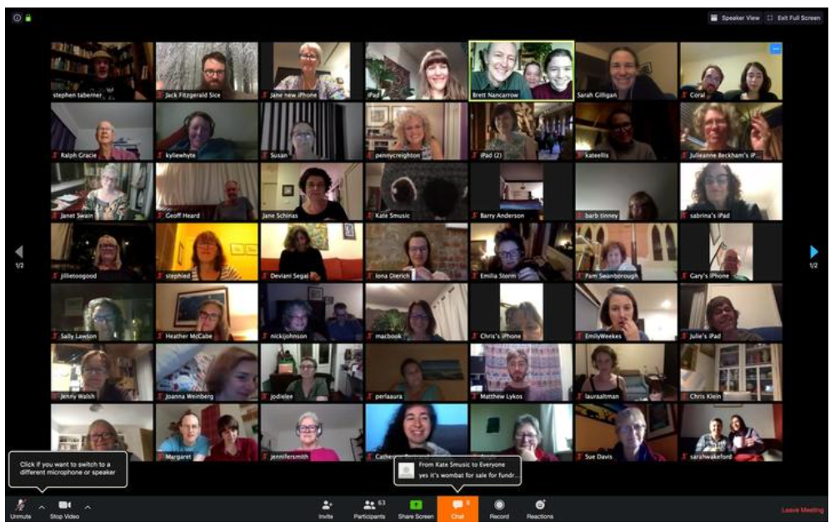
Singing in an international community choir of over 400
but hard to sing in tune alone in my room
Stephen Ttaberner Massive Singlet, https://www.massivesinglet.com/

Slide 13
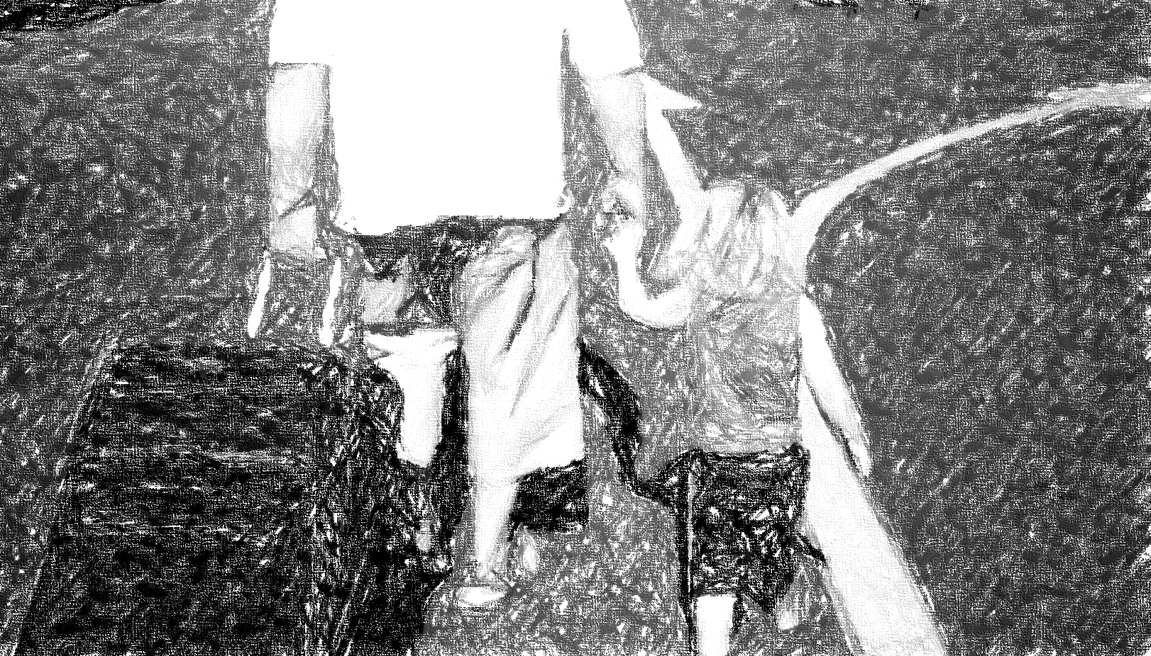
And after 2020? Have we finished?
vaccine perhaps
but other different pandemics?
increasing violent weather
more fires
growing political divisions
truth v. propaganda
more displacement of people
fluctuating economics

Slide 14
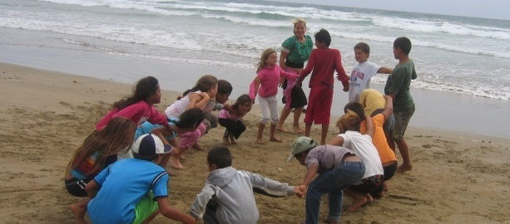
We use art in education
to understand what’s happening, to make meaning in the face of problems,
to explore ways of making change
we are body, as well as mind
we know & communicate through all our senses, not just words
we know things in other ways than intellectual

Slide 15
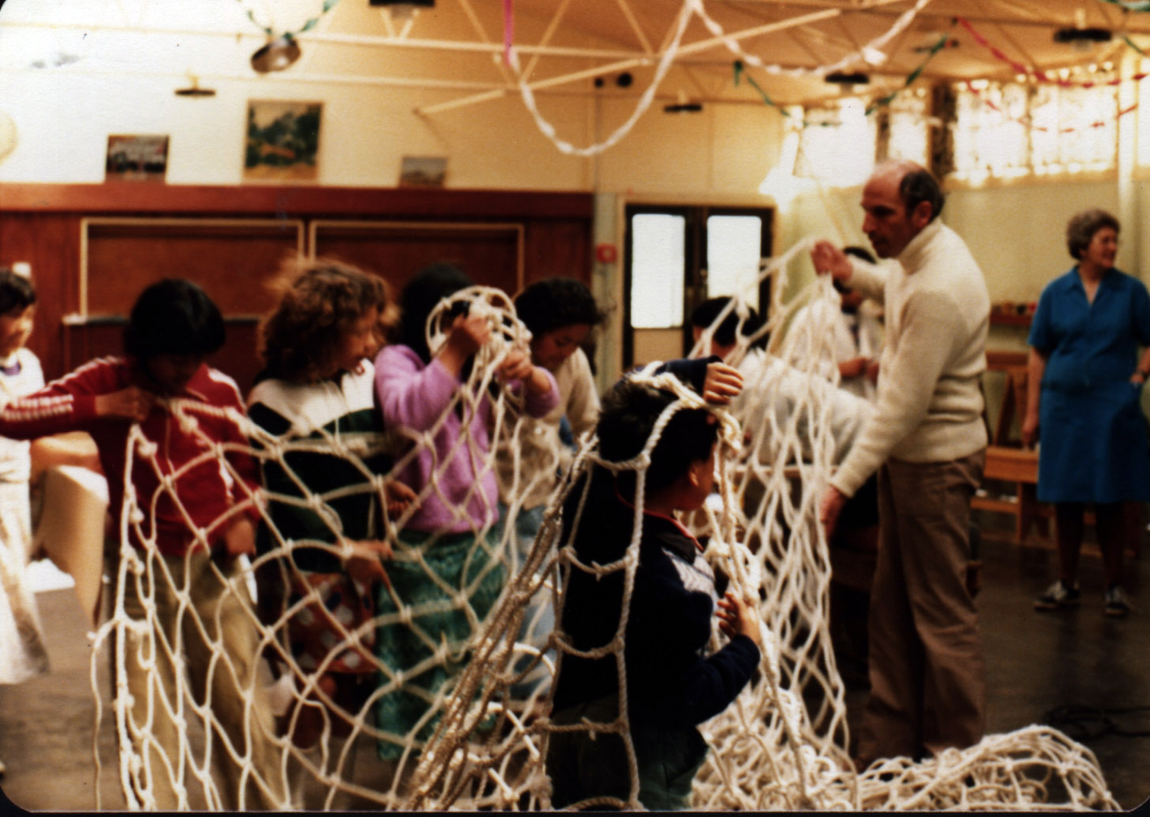
what values what skills
do our young people need to face the future?
preserve capacity to share, love, empathise
team work
ability to see things differently
evolve flexibility and resilience
retain sense of team and community
develop criticality and ingenuity

Slide 16
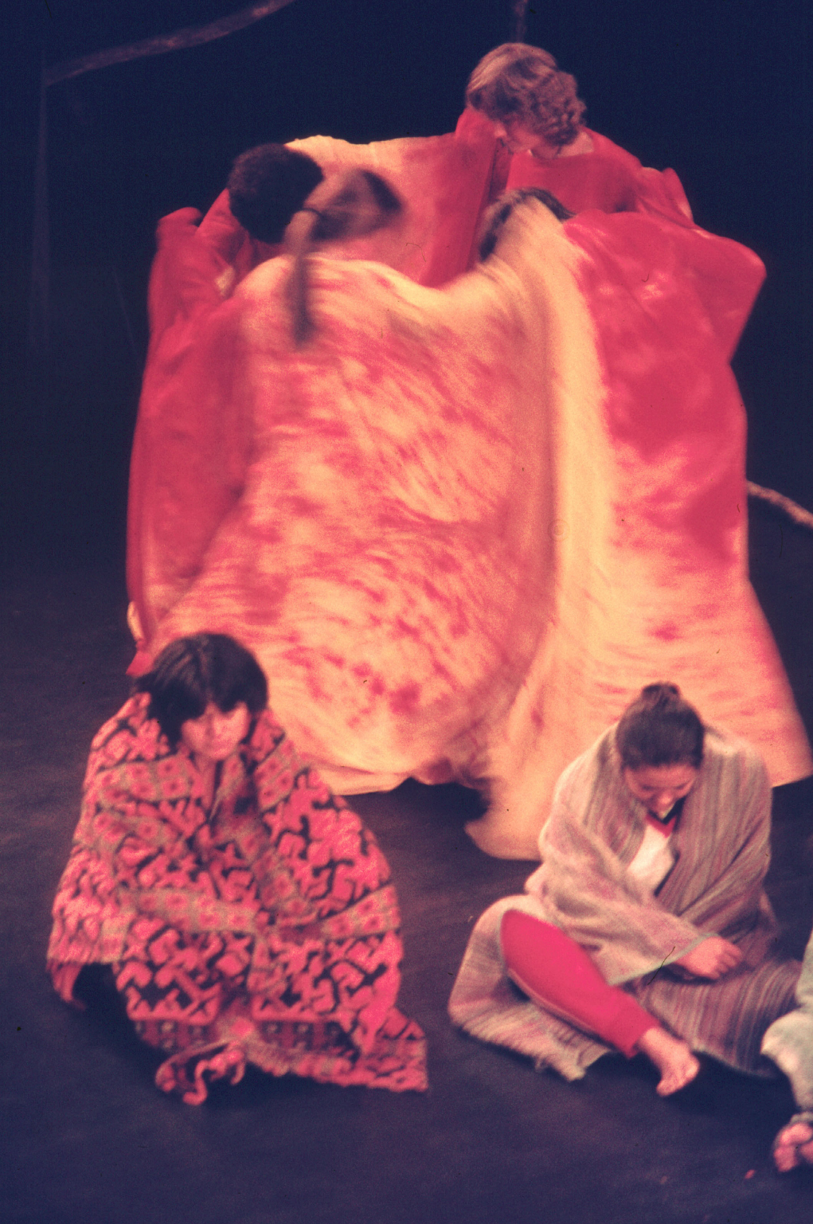
What drama offers for teaching and learning
experiential, imagined, visceral, enacted
agency
exploration & management of role
framing of conflict
strategies of analysis & deconstruction
group work, commitment, focus
performance/ pre-formance

Slide 17
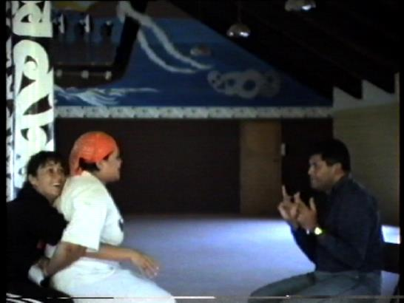
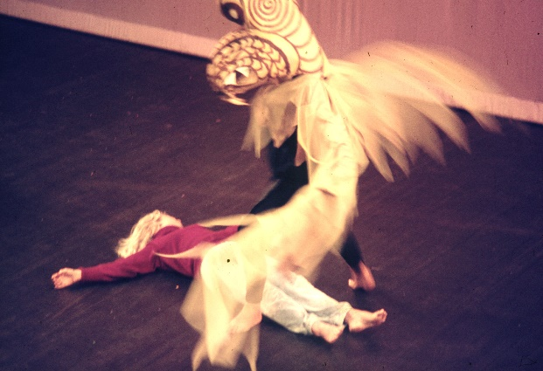
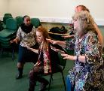
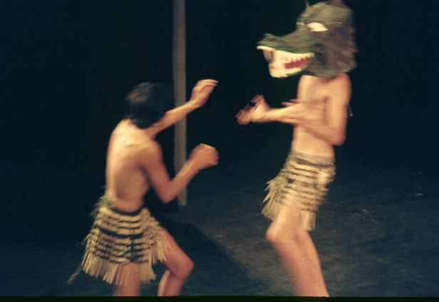
When we are shut inside, how can we use drama to deal with what is going on outside?
Many of our drama activities are blocked:
schools shut or reduced activities
clubs, youth groups shut
no touching
masked faces and muffled voices
Is it possible to work with the elements & tools of drama for teaching when we are socially isolated?
In lockdown, not easily:
Drama is an interactive, physical & social art medium
Teaching through drama is interactive & reactive
On-going analytic reflection is key part of process
Masked and socially isolated?: Yes, but will take rethinking:

Slide 18
tension
focus
time space movement sound
Body
Voice
Ritual
fictional role
story
Improv
devising
Script
Theatre cannon
actor training
relaxation
healing
physical theatre
games
psychodrama
Process drama
ceremony
transformation
clown
mime
symbol
theatre sports
creativity
interpersonal skills
playback theatre
new plays
actor training
stage production
interpretation
theatre history
performance style
vicarious experience
deconstruction
social critique
forum theatre
range of specific conventions relating to traditions and intentions
theory and practice

Slide 19
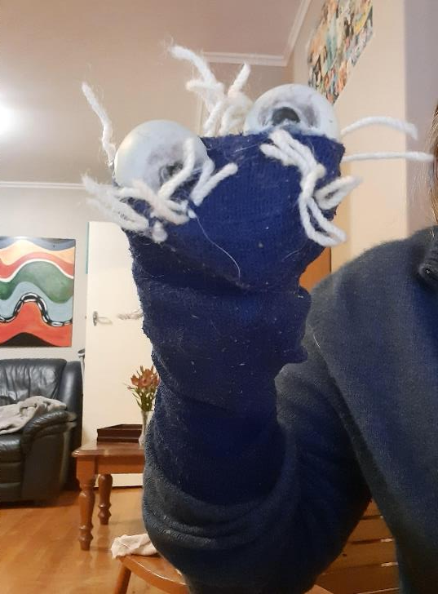
Young children &work on Zoom
Livening up the meeting with sock puppets
Sock puppets are easy to make
And children quickly learn to animate them
A great way to express uncomfortable feelings, ideas, reactions
The puppet can say things the child or the teacher does not want or is shy to say.
The puppet can argue with its operator

Slide 20
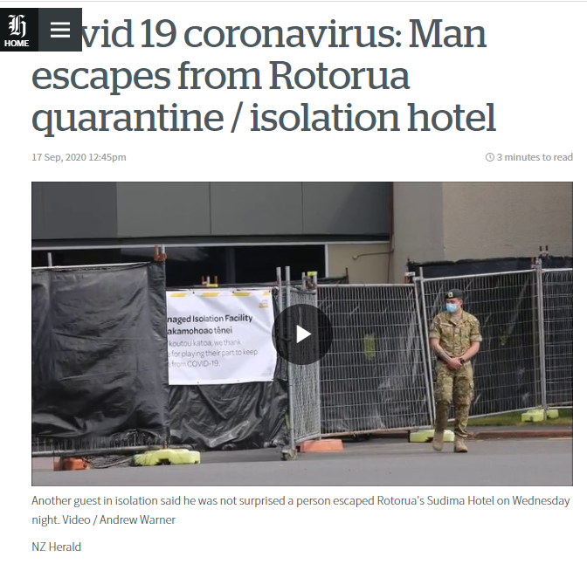
Older students – socially distanced
Devise and present a doco-drama, using projected visual images and a collage of monologues.
Pick an issue or news event that is either current and significant , or on-going – but still significant.
Select a number of roles whose view points would be useful in illuminating the issue.
Write a monologue for each of these.
Cut each monologue into 4-5 sections
Interweave the sections of the four monologues.
Present the collage. In this presentation the characters will stand on the same physical stage but tell their stories in completely separate dramatic spaces.
Select images that relate to the topic (these may be illustrative or counterpointal)
Either scan these so that they can be projected through a data projector (using powerpoint allows a very tidy finish), or make them into OHTs or make an I-movie
Put this all together to create a doco-drama

Slide 21
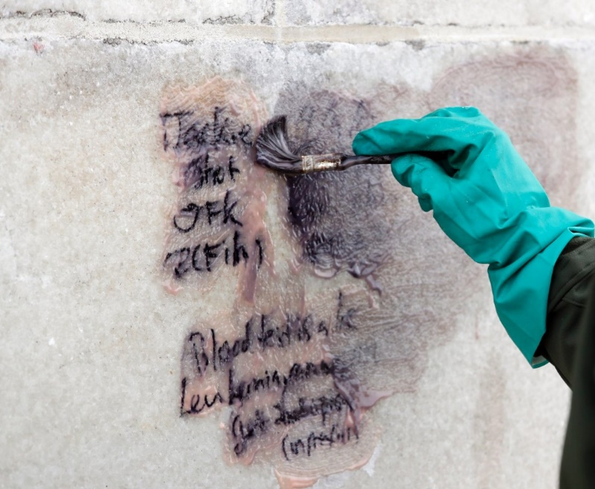
8 checks for using drama to learn about big issues
Create a platform to work from ( a frame? a point of entry?)
The big issues in today’s world need to be explored but their very bigness may make them seem difficult to work with
Learners need to be drawn into the exploration with something small, do- able
e.g.
The people who live on the hill look down on those who live in the valley. One day a young gang decide to graffiti the wall that leads into the valley. What did they write?
The task is first recreate the graffiti - without taking role.
Then the teacher/facilitator invites learners to imagine a scene in a pub where a writer talks about the graffiti. Next scene change to a homes in the valley where at dinner one member of the family talks about the graffiti seen on the way home.
The drama can then build to exploration of one of the polarisations in our current world

Slide 22
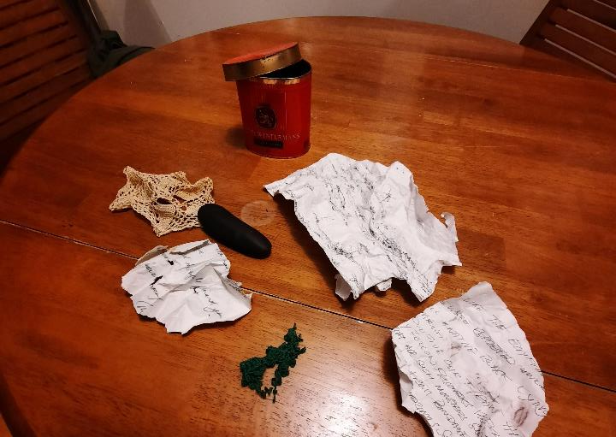
Create opportunity for thought, emotional reaction, creativity
Using an art form does not in itself prevent top-down instruction or replication
e.g.
An old man in a refugee camp always carried a cigar tin in his pocket. He lost it when a fire started in the camp. A boy found it. It contained a sketched map, a smooth stone, a scrap of lace and a torn letter.
The task is to create a scene where one of these items came into the man’s life, showing why it was precious to him.
The drama can then build to exploration of what made him a refugee, what happened in the camp, etc

Slide 23
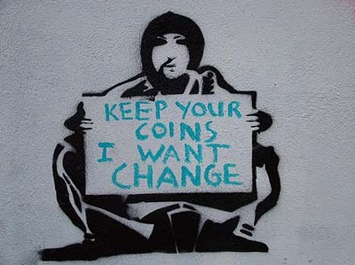
Bridge from the known to the less known
We meet many of the big issues as generalised abstractions.
Drama invites examination of the human and particular.
At each stage of the drama learners need to be able to lean on and play with what they already know before reaching out to the unknown
e.g
The graffiti drama starts without role – participants just recall graffiti they have already seen. As they then take role they have already something to build on. Each frame they work in builds a platform of background knowledge they can draw on for substance as they explore the next challenge.
Banksy

Slide 24
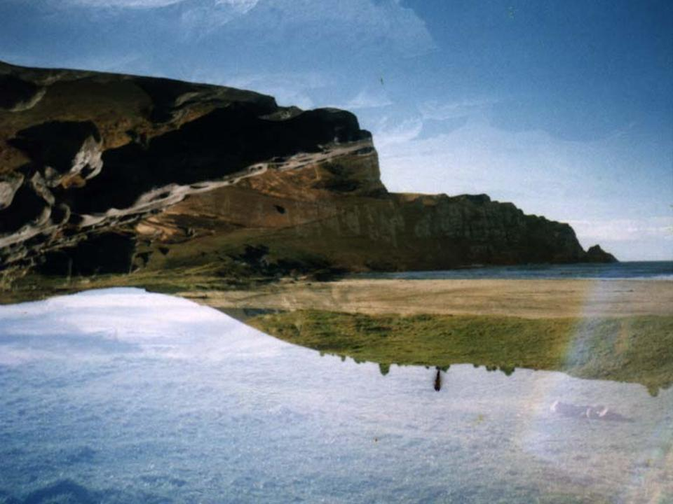
Facilitate the development of multiple view points
In our everyday lives we often already have a particular attitude to issues in the world. And our minds tend to merge new information into what we already hold.
In the image below the cliff seems to be reflected in the water. A careful look reveals an different land form.
Working with drama invites us to step outside ourselves into another role and seek a different way of seeing.
The use of role and fictional frames allows the shifts.
e.g
Using a traditional story of the Billy Goats Gruff and the troll that lives under the bridge, participants are encouraged to develop accounts of troll behaviour and troll culture through the billy goats’ eyes.
Then the teacher/facilitator picks up the narrative, explaining that the trolls are the ancestral guardians of the river and describing the carnage the goats cause with their indiscriminate eating. Participants are invited to in-inscribe the history and cultures of the two groups through troll eyes.
Greenwood, 2002

Slide 25
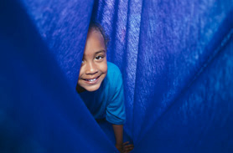
Develop a ‘safe’ or manageable space
The concept of drama creating a safe space is widely described and contested.
Safe does not mean insulated from challenging ideas or uncomfortable discoveries.
The fiction of role creates allowances and suspends criticism.
But the exploratory space and the risks taken within it need to be managed, by both teacher and learners.
e.g
In Mostar, Bosnia, a colleague and I used the story of the Billy Goats Gruff to create a careful entry into the sectarian wars that had devastated the city and its bridge. To have talked at the start about religion and the massacres would have been perhaps dangerous and probably unproductive, but at a certain point in the drama the participants themselves started drawing parallels, and in time the drama moved openly to recent history and possible futures.

Slide 26

Create opportunities to record violence without losing control of it
Often violence is an integral part of the story.
Sometimes participants want to indulge in horror, either macabre or comic.
But acting violence and horror can be unconvincing. It can get uncontrolled. It may be dangerous.
It’d time to use performative strategies.
e.g
A photo essay using freeze frames/ body sculptures of war or atrocities allows a disciplining and thoughtful acknowledgment of violence. The making of the images and reflection on them becomes part of the platform of what is known.
Sometimes participants want to offer implausible rescues or nightmare fantasies. I tend to accept them, and re-narrate them as dreams of what those in the story hoped or feared would happen, but actutally…..

Slide 27

Build and stretch tension
Drama is powerful, and fun, when a challenge interrupts the narrative.
Learning happens when we don’t know the answer.
The teacher/facilitator needs to allow a storyline to develop long enough to make it believable for the participants before intervening with a challenge.
e.g
A person from the valley and one from the hill fall in love (Romeo and Juliet or Othello). A person from the hill needs to borrow money from someone in the valley (The Merchant of Venice).
The man with the cigar tin is still young and he is offered a choice…..

Slide 28
There is skilled craft involved in using drama for learning
It’s not necessary for learners or facilitator to be great actors: role is more about commitment than skill.
But the teacher/ facilitator needs to develop skilled craftsmanship in selecting entry points, making dramatic interventions and in enabling reflection.
The skilled craft is in morphing play into learning.
e.g
In the graffit dram we can peer through the window of each house to listen to what’s discussed at the dinner table, The facilitator decides when enough tension has built and before it begins to flatten she draws the shutters.
art freedom
Strategy constraint

Slide 29
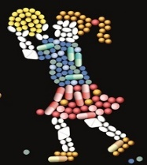

In a locked down Covid world we are trapped inside
and outside the world’s turbulences and dangers rage
By using drama
we take some ownership of what is happening outside
we filter it inside our imaginative experience, process it, make sense of it, mark it
The outside becomes resource for our inside
Our inside stretches to embrace the wider world
We may not be able to change the outside to a great extent:
we can change our way of being within the outside.

Slide 30
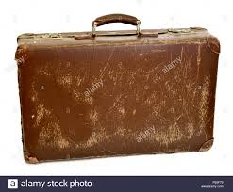
Some selected references
Bharucha, R. (1993). Theatre and the world: Performance and the politics of culture. London: Routledge.
Boal, A. (1979). Theatre of the oppressed. London: Pluto Press.
Boal, A. (2006). Theatre of the oppressed. Oxford: Routledge. Trans. Adrian Jackson.
Brandt, W. S. & Harcourt, M. (1994). Verbatim. Wellington: Victoria University Press.
Conrad, D. (2012). Athabasca’s going unmanned. Rotterdam; Boston: Sense.
Greenwood J. (2012). Arts-based research: Weaving magic and meaning. International Journal of Education & the Arts 13(Interlude 1). http://www.ijea.org/v13i1/v13i1.pdf.
Greenwood, J. (2005). Playing with Curriculum. Invercargill: Essential Resources.
Greenwood, J. (2010). Aesthetic learning, and learning through the aesthetic. In S.Shonmann (Ed). Key Concepts in Theatre/Drama Education. Rotterdam: Sense Publishers.
Greenwood, J. (2012). Strategic Artistry. Asia Pacific Journal for Arts Education
Greenwood J. & McCammon L. (2008). The bridge, the trolls, and a number of crossings: a foray into the 'third space'. NJ: Drama Australia Journal 31(1): 55-68
Heathcote, D., & Bolton, G. (1995). Drama for learning: Dorothy Heathcote's mantle of the expert approach to education. Portmouth: Heinemann.
O’Brien, A. & Donelan, K. (2008) Creative interventions for marginalised youth: The Risky Business Project. Drama Australia. Monograph 6.
O’Toole, J. (1992)., The Process of Drama: Negotiating Arts and Meaning. London & New York: Routledge,
Sæbø, A.B. (2009). Drama and student active learning. A study of how drama responds to the didactical challenges of the teaching and learning process. Trondheim: NTNU.
Saldaña, J. (2008). Ethnodrama and ethnotheatre. In J.Knowles & A. Cole (Eds.), Handbook of arts in qualitative research (pp.195-207). Thousand Oaks, CA: Sage.
Schonmann, S. (2016). Making sense of art education: Wrestling with two critical myths in the field. In A. Sæbø (Ed.). International yearbook for research in arts education. Munster: Waxman

